Slide 1
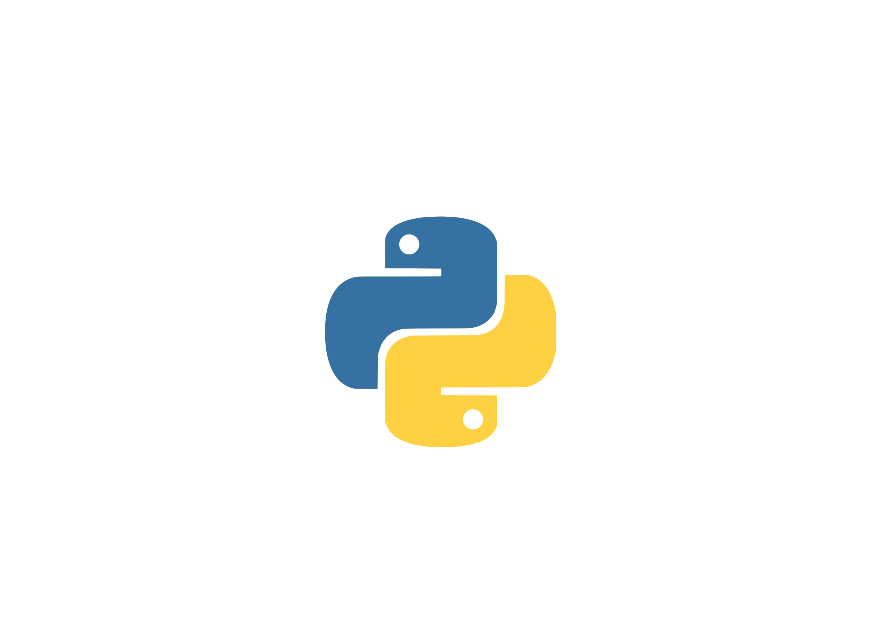
Python Tuples

Slide 2
Introduction
A tuple is a collection which is ordered and separated by commas
Tuples are defined by enclosing the elements in parentheses (())
In someway a tuple is similar to a list in terms of indexing, nested objects and repetition
Unlike lists, tuples are immutable

Slide 3
Creating Tuples
Creating empty tuple:
Creating non-empty tuples:
>>> empty_tuple = () #creates an empty tuple
>>> print(empty_tuple)
()
>>> type(empty_tuple) #checking type
<class 'tuple'>
>>> tup1 = ('John', 'Jane')
>>> print(tup1)
('John', 'Jane')
>>> tup2 = 'John', 'Jane' #without using parenthesis
>>> print(tup2)
('John', 'Jane')

Slide 4
Creating Tuples
Tuple supports mixed data types:
Nested tuples: (tuple inside a tuple)
>>> my_tuple = ('John', 'Jane', 24)
>>> print(my_tuple)
('John', 'Jane', 24
>>> my_tuple = ('John', 'Jane',(1,2,3), ['a', 'b'])
>>> print(my_tuple)
('John', 'Jane', (1,2,3), ['a', 'b'])

Slide 5
Creating Tuples
Creating a tuple with one element is a bit tricky:
>>> my_tuple = ('John') #without comma it is treated as a string
>>> print(my_tuple)
John
>>> type(my_tuple)
<class 'str'> # shows class str
>>> my_tuple = ('John',) # comma is needed
>>> print(my_tuple)
('John',)
>>> type(my_tuple)
<class 'tuple'>

Slide 6
Creating Tuples
tuple() function: a built-in function in Python that can be used to create a tuple
Syntax:
tuple() function accepts a single parameter iterable (optional)
If an iterable is passed, the corresponding tuple is created
If iterable is not passed, empty tuple is created
tuple(iterable)

Slide 7
tuple() function examples:
>>> my_tuple = tuple() #without an iterable
>>> print(my_tuple)
()
>>> my_tuple = tuple([1,2,3,4]) #using list as a parameter
>>> print(my_tuple)
(1,2,3,4)
>>> my_tuple = tuple("hello") #using string as a parameter
>>> print(my_tuple)
('h', 'e', 'l', 'l', 'o')
>>> my_tuple = tuple(1) # int is not an iterable
Traceback (most recent call last):
File "<stdin>", line 1, in <module>
TypeError: 'int' object is not iterable

Slide 8
Tuple packing and unpacking
As shown in the previous slide, we can create tuple without using parenthesis, that is called tuple packing.
Tuple packing with only one element:
>>> my_tuple = 'John', 'Jane', 24
>>> print(my_tuple)
('John', 'Jane', 24)
>>> my_tuple = (1,2,3), ['a','b'], ('John', 'Jane')
>>> print(my_tuple)
((1,2,3), ['a','b'], ('John', 'Jane'))
>>> my_tuple = 'John', # you need a comma
>>> print(my_tuple)
('John',)

Slide 9
Tuple packing and unpacking
The contrary is also possible, which is called tuple unpacking
>>> my_tuple = ('John', 'writer', 23)
>>> name, profession, age = my_tuple
>>> print(name)
John
>>> print(profession)
writer
>>> print(age)
23

Slide 10
Unpacking errors:
Number of variables on the left must match the number of values in the tuple.
>>> my_tuple = ('John', 'writer', 23)
>>> name, profession = my_tuple # less variables than expected
Traceback (most recent call last):
File "<stdin>", line 1, in <module>
ValueError: too many values to unpack (expected 2)
>>> name, profession, age, address = my_tuple # more variables than expected
Traceback (most recent call last):
File "<stdin>", line 1, in <module>
ValueError: not enough values to unpack (expected 4, got 3)

Slide 11
Accessing Tuple Elements
Indexing: we can use the index operator [] to access an item in a tuple, where the index starts from 0.
>>> my_tuple = ('John', 'writer', 23)
>>> print(my_tuple[0])
John
>>> print(my_tuple[2])
23
>>> print(my_tuple[3]) # there is no element in index 3
Traceback (most recent call last):
File "<stdin>", line 1, in <module>
IndexError: tuple index out of range

Slide 12
Accessing Tuple Elements
Negative Indexing: Index of -1 refers to the last item, -2 to the second last item and so on.
>>> my_tuple = ('John', 'writer', 23)
>>> print(my_tuple[-1])
23
>>> print(my_tuple[-2])
writer
>>> print(my_tuple[-3])
John
>>> print(my_tuple[-4])# there is no element in index -4
Traceback (most recent call last):
File "<stdin>", line 1, in <module>
IndexError: tuple index out of range

Slide 13
Accessing Tuple Elements
Slicing: We can access a range of items in a tuple by using the slicing operator colon :
Syntax:
[Start index (included):Stop index (excluded):Increment]
>>> my_tuple = ('a', 'b', 'c', 'd', 'e', 'f', 'g')
>>> print(my_tuple[:]) #gives all elements
('a', 'b', 'c', 'd', 'e', 'f', 'g')
>>> print(my_tuple[1:3]) # includes from index 1-2, index 3 is excluded
('b', 'c')
>>> print(my_tuple[-3:])
('e', 'f', 'g')
>>> print(my_tuple[:-4])
('a', 'b', 'c')

Slide 14
More on slicing
>>> my_tuple = ('a', 'b', 'c', 'd', 'e', 'f', 'g')
>>> print(my_tuple[::2]) # starts from 0 index with increment of 2
('a', 'c', 'e', 'g')
>>> print(my_tuple[1:5:2]) #index 1-5,index 5 excluded, with increment of 2
('b', 'd')
>>> print(my_tuple[-3:])
('e', 'f', 'g')
>>> print(my_tuple[:-4])
('a', 'b', 'c')
Tip: You can also use the negative increment value to reverse the tuple.
>>> print(my_tuple[::-1])
('g', 'f', 'e', 'd', 'c', 'b', 'a')

Slide 15
Deleting a Tuple
Tuple can be deleted using del keyword
>>> my_tuple = ('a', 'b', 'c', 'd', 'e', 'f', 'g')
>>> del my_tuple
>>> print(my_tuple) # my_tuple has already been deleted, raises NameError
Traceback (most recent call last):
File "<stdin>", line 1, in <module>
NameError: name 'my_tuple' is not defined

Slide 16
Tuple Operations
Concatenation: we can use + operator to combine two tuples. This is called concatenation
Repetition: we can use * operator to repeat a tuple.
>>> tup1 = ('a', 'b', 'c')
>>> tup2 = ('d', 'e', 'f')
>>> print(tup1 + tup2) # concatenate tup2 to tup1
('a', 'b', 'c', 'd', 'e', 'f')
>>> tup1 = ('a', 'b', 'c')
>>> print(tup1*2) # repeats tup1 2 times
('a', 'b', 'c', 'a', 'b', 'c')

Slide 17
Tuple Operations
Tuple Membership Test: we can perform membership test using the in keyword
>>> tup1 = ('a', 'b', 'c')
>>> 'a' in tup1
True
>>> tup1 = ('a', 'b', 'c')
>>> 'b' not in tup1
False

Slide 18
Tuple Operations
Iteration:
>>> tup1 = ('a','b')
>>> for x in tup1:
... print(x)
...
a
b
>>> tup2 = (1,2,3)
>>> for _ in tup2:
... print("Hello")
...
Hello
Hello
Hello

Slide 19
Tuple methods:
Unlike Python lists, tuples does not have methods such as append(), remove(), extend(), insert() and pop() due to its immutable nature.
There are only two tuple methods count() and index() that a tuple object can call.

Slide 20
Tuple methods:
count(): returns the number of times the specified element appears in the tuple
Syntax:
Parameter: element - the element to be counted
tuple.count(element)
>>> tup1 = ('a', 'b', 'c', 'a',('a','b'))
>>> tup1.count('a')
2
>>> tup1.count(('a', 'b'))
1

Slide 21
Tuple methods:
index(): returns the index of the specified element in the tuple.
Syntax:
Parameters:
element - the element to be searched
start (optional) - start searching from this index
end (optional) - search the element up to this index
index() method only returns the first occurrence of the matching element.
tuple.index(element, start, end)

Slide 22
tuple.index() examples:
>>> tup1 = ('a', 'b', 'c', 'a',('a','b'))
>>> tup1.index('a')
0
>>> tup1.index('a', 1, 4) #start from index 1, end at index 4
3
>>> tup1.index('z') # 'z' is not in the tuple, raises ValueError
Traceback (most recent call last):
File "<stdin>", line 1, in <module>
ValueError: tuple.index(x): x not in tuple
>>> tup1.index('b', 2, 4) #'b' is in tuple but not in between start and end index
Traceback (most recent call last):
File "<stdin>", line 1, in <module>
ValueError: tuple.index(x): x not in tuple

Slide 23
Some functions that can be used in tuples:
sum(): Adds items of an iterable. In this case, a tuple
While using sum(), make sure your tuple contains number data type only
>>> tup1 = (1,2,3,4,5)
>>> sum(tup1)
15
>>> tup1 = (1,2,3,4,'a')
>>> sum(tup1)
Traceback (most recent call last):
File "<stdin>", line 1, in <module>
TypeError: unsupported operand type(s) for +: 'int' and 'str'

Slide 24
Some functions that can be used in tuples:
max(): returns the largest item
min(): returns the smallest value
>>> tup1 = (1,2,3,4,5)
>>> max(tup1)
5
>>> tup1 = (1,2,3,4,5)
>>> min(tup1)
1

Slide 25
Some functions that can be used in tuples:
sorted(): returns a sorted list from the given iterable
reversed(): returns the reversed iterator of a sequence
>>> tup1 = (2,3,1,4,5)
>>> list(sorted(tup1))
[1,2,3,4,5]
>>> tup1 = (1,2,3,4,5)
>>> reversed(tup1) #this gives reversed object
<reversed object at 0x7fa0c61ce8d0>
>>> list(reversed(tup1)) #convert reversed object to list
[5,4,3,2,1]

Slide 26
Python Dictionaries

Slide 27
Dictionaries in Python
Collection of key-value pairs separated by comma (,)
Each key-value pair maps the key to its associated value
Built-in dictionary class named "dict"
Insertion order of the item is preserved
from Python 3.7 and onwards
In previous Python versions (before 3.7),
dictionaries were unordered collections
>>> my_dict = {
... <key_1>: <value_1>,
... <key_2>: <value_2>,
... .
... .
... .
... <key_n>: <value_n>,
...}

Slide 28
Creating Dictionary in Python
Keys in a dictionary must be of immutable type(string, number, or tuple) and must be unique
Values in a dictionary can be of any type and can repeat
>>> # empty dictionary
>>> d = {}
>>> # dictionary with string keys
>>> d = {'name': 'John, 'surname': 'Doe'}
>>> print(d)
>>> {'name': 'John', 'surname': 'Doe'}
>>> # dictionary with mixed keys
>>> d = {'name': 'Jane', 2: ['a', 'e']
>>> print(d)
>>> {'name': 'Jane', 2: ['a', 'e']}

Slide 29
Creating Dictionary in Python ...
Using builtin dict() function
>>> # empty dictionary
>>> d = dict()
>>> d = dict(
... name='John',
... surname='Doe'
... }
>>> print(d)
>>> {'name': 'John', 'surname': 'Doe'}
>>> d = dict({
... 'name': 'John',
... 2: ['a', 'e']
... })
>>> print(d)
>>> {'name': 'Jane', 2: ['a', 'e']}
>>> d = dict([
... ('name', 'John'),
... ('age', 23),
... ('gender', 'male')
... ])
>>> print(d)
>>> {'name': 'John', 'age': 23, 'gender': 'male'}

Slide 30
Accessing Values in Dictionary
Not accessible using index value
Value can be accessed using square brackets []
While trying to get value of non-existing key of dictionary, KeyError will be raised
You can also assign the value to non-existing key in a dictionary
>>> d = {
... 'name': 'John',
... 'surname': 'Doe'
... }
>>> print(d['name'])
>>> 'John'
>>> print(d['last_name'])
Traceback (most recent call last):
File "<stdin>", line 1, in <module>
KeyError: 'last_name'
>>> d = {
... 'name': 'John',
... 'surname': 'Doe'
... }
>>> try:
... print(d['age'])
... except KeyError:
... d['age'] = 23
... print(d['age'])
...
23

Slide 31
Accessing Values in Dictionary ...
Dictionary value is accessible using get() method on dictionary object
Unlike square brackets, get() method will not raise error while accessing non-existing key. It will return None instead.
You can easily add default value, if None returned by get() method.
>>> d = {
... 'name': 'John',
... 'surname': 'Doe'
... }
>>> print(d.get('name'))
>>> 'John'
>>> print(d.get('last_name'))
None
>>> d = {
... 'name': 'John',
... 'surname': 'Doe'
... }
>>> print(d.get('age', 23))
23

Slide 32
Adding and Updating items in Dictionary
Using key which is not already in use will create new key-value pair
Using key which is aready associated with some value will forgets the previus associated value
>>> # Adding item in a dictionary
>>> d = {
... 'name': 'John'
... }
>>> d['age'] = 23
>>> print(d)
>>> {'name': 'John', 'age': 23 }
>>> d['lang'] = ['Java', 'Python']
>>> print(d)
>>> {'name': 'John', 'age': 23, 'lang': ['Java', 'Python']
>>> # Updatingitem in a dictionary
>>> d = {
... 'name': 'John',
... 'age': 23,
... 'lang': ['Java', 'Python']
... }
>>> d['name'] = 'Jane'
>>> print(d)
>>> {'name': Jane, 'age': 23, 'lang': ['Java', 'Python']

Slide 33
Removing Items from Dictionary
pop() method on a dictionary removes the item with provided key and returns value
popitem() method removes the item that was last inserted in dictionary and returns the removed pair
(Changed in version 3.7: LIFO order is now guaranteed. In prior versions, popitem() would return an arbitrary key/value pair.)
clear() method is used to remove all key-value pair from the dictionary
del keyword removes the entire dictionary itself

Slide 34
Removing Items from Dictionary ...
we have a dictionary d as defined below and we are using it separately in the following examples:
d = {'a': 1, 'b': 2, 'c': 3, 'd':4, 'e': 5}
>>> print(d.pop('b'))
2
>>> print(d)
{'a': 1, 'c': 3, 'd': 4, 'e': 5}
>>> d.clear()
>>> print(my_dict)
{}
>>> del d
>>> print(d)
Traceback (most recent call last):
File "<stdin>", line 1, in <module>
NameError: name ‘d' is not defined
>>> print(d.popitem())
('e', 5)
>>> print(d)
{'a': 1, 'c': 3, 'd': 4}

Slide 35
Restriction in Dictionary Keys and Values
Restriction in dictionary keys:
a dictionary key must be immutable
Restriction in dictionary Values:
there are no restrictions on dictionary values
Note: Tuples can be used as keys, if they contain only immutable objects
If a tuple contains any mutable object either directly or indirectly, it cannot be used as keys.

Slide 36
Dictionary Membership
in operator is used to check dictionary membership
If variable y holds {'a': 1, 'c': 3, 'd': 4, 'b': 2, 'e': 5} then:
>>> print('a' in y) # checks if 'a' is in key of y
True
>>> print('y' in y) # checks if 'y' is in the key of y
False
>>> print('e' not in y) # checks if 'e' is not in the key of y
False

Slide 37
Built-in Functions that work on Dictionary
There are many Python built-in functions that work on dictionary and few of them are:
Function | Description
all() | If all keys of the dictionary are True (or if the dictionary is empty), return True.
any() | If any key of the dictionary is true, return True. If the dictionary is empty, return False.
len() | Return the length (the number of items) in the dictionary.
sorted() | Returns a new sorted list of keys in the dictionary.
str() | Produces a printable string representation of a dictionary.
type() | Return type of the object passed.

Slide 38
Built-in Functions (examples)...
If variable a holds a dictionary {'x': 1, 'Z': 3, 'y': 2}
>>> print(all(a))
True
>>> print(any(a))
True
>>> print(all({}))
True
>>> print(any({}))
False
>>> print(all({'': 2, 'x': 3}))
False
>>> print(any({'': 2, 'x': 3}))
True
>>> print(len(a))
3
>>> print(sorted(x))
['x', 'y', 'z']
>>> print(sorted(x, reverse=True))
['z', 'y', 'x']
>>> str(a)
"{'x': 1, 'z': 3, 'y': 2}"
>>> type(a)
<class 'dict'>

Slide 39
Dictionary Methods
Few among the given dictionary methods are already used in above examples.
Method | Description
clear() | Removes all elements from the dictionary.
copy() | Returns a copy of the dictionary.
fromkeys(seq) | Returns a new dictionary with keys from seq and values set to value.
get(key, default=None) | Returns the value of the key. If the key does not exist, defaults to None.
items() | Return a list of the dictionary's items in (key, value) format.
keys() | Returns a list of the dictionary's keys.

Slide 40
Dictionary Methods ...
Method | Description
pop(key) | Removes the item with the key and returns its value.
popitem() | Removes the item that was last inserted in dictionary and returns the removed pair
setdefault(key, default=None) | Like get(), but will set dictionary key to default if key is not already in dictionary
update(dict2) | Updates the dictionary with the key/value pairs from other, overwriting existing keys.
values() | Returns a list of the dictionary's values

Slide 41
Dictionary Methods (examples)...
If variable y holds {'a': 1, 'c': 3, 'd': 4, 'b': 2} then:
>>> print(y.keys())
dict_keys(['a', 'c', 'b', 'd'])
>>> x = y.copy()
>>> print(x)
{'a': 1, 'c': 3, 'b': 2, 'd': 4}
>>> print(y.values())
dict_values([1, 3, 2, 4])
>>> a = {'e': 5}
>>> y.update(a)
>>> y
{'a': 1, 'c': 3, 'd': 4, 'b': 2, 'e': 5, 'f': 1}
>>> print(y.items())
dict_items([('a', 1), ('c', 3), ('b', 2), ('d', 4)])

Slide 42
Dictionary Methods (examples)...
If variable y holds {'a': 1, 'c': 3, 'd': 4, 'b': 2} then:
>>> a = y.fromkeys(['e', 'f'], 1)
>>> print(a)
{'e': 1, 'f': 1}
>>> b = y.fromkeys(['e', 'f’])
>>> print(b)
{'e': None, 'f': None}
>>> y.setdefault('c', 1)
>>> print(y)
{'a': 1, 'c': 3, 'd': 4, 'b': 2}
>>> y.setdefault('e', 5)
>>> print(y)
{'a': 1, 'c': 3, 'd': 4, 'b': 2, 'e': 5}

Slide 43
Iterating through a Dictionary
Using for loop (If variable y holds {'a': 1, 'c': 3, 'd': 4, 'b': 2}):
>>> for item in y:
... print(item)
...
a
c
d
b
>>> for item in y.items():
... print(item)
...
('a', 1)
('c', 3)
('d', 4)
('b', 2)
>>> for item in y.values():
... print(item)
...
1
3
4
2
>>> for key, value in y.items():
... print(key, value)
...
a 1
c 3
d 4
b 2

Slide 44
Tasks
Write a program which takes radius as an input and calculate the area of the circle. Pi*r**2
Write a program to find the frequency of the input number in a list
[5, 2, 3, 5, 3, 2, 3, 3, 1, 4]
Write a program which takes radius as an input and calculate the circumference of the circle
Take l and b as an input and find area of a rectangle.

